Slide 1

Behavioral-Drift Fraud Detector
Federated Learning with Personalized Baselines
Mrs. Rupa Devi
Team members:
A.Abhinava Reddy
S.Sandeep Rao
V. Sritej
Y. Gunavardhan

Slide 2
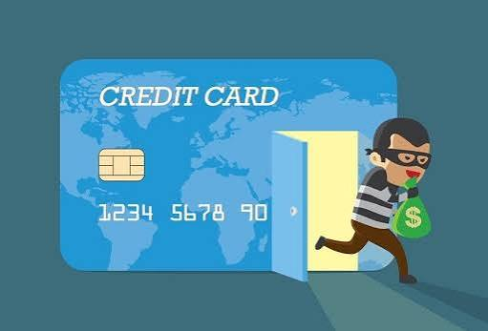
Abstract
Credit card fraud is rising rapidly worldwide
Banks cannot share raw customer data due to privacy laws
Federated Learning enables collaborative model training without data sharing
Existing FL systems only learn generic, global fraud patterns
Proposed work adds personalized behavioral-drift detection per user
Improves fraud detection accuracy while reducing false positives

Slide 3
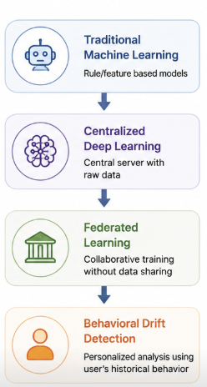
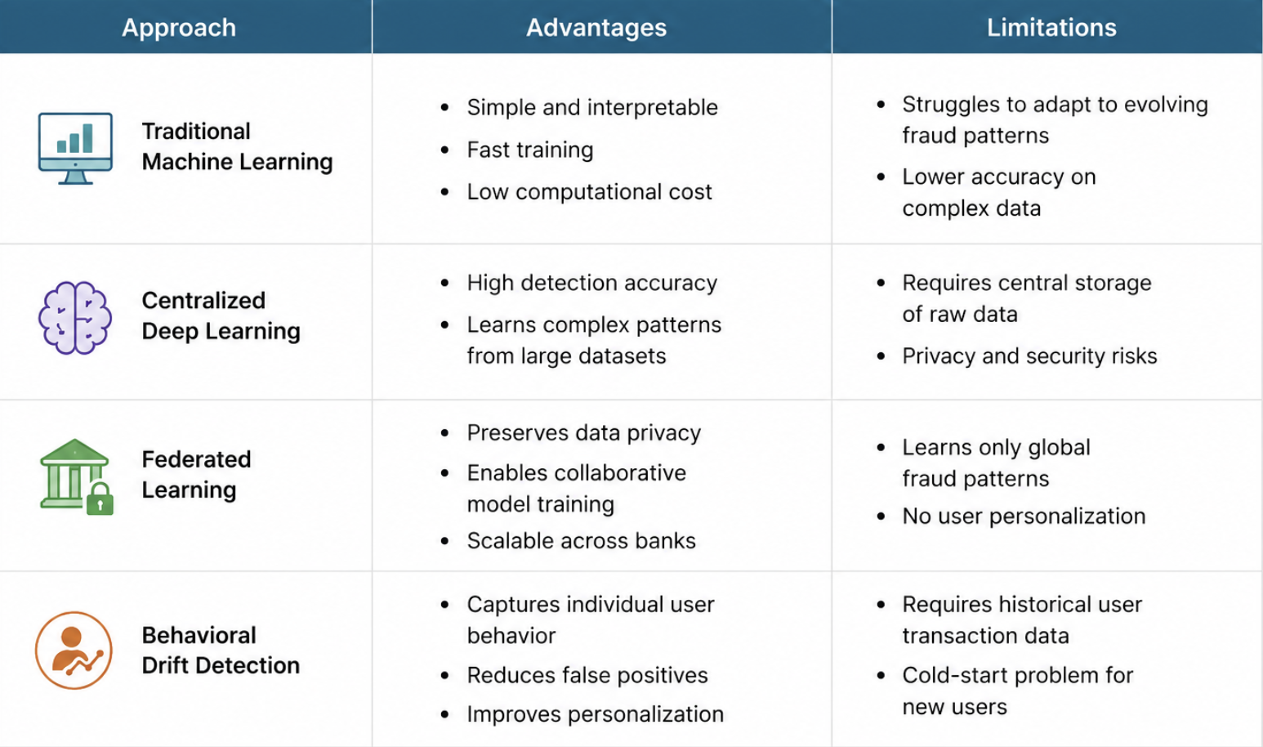
Literature Survey

Slide 4
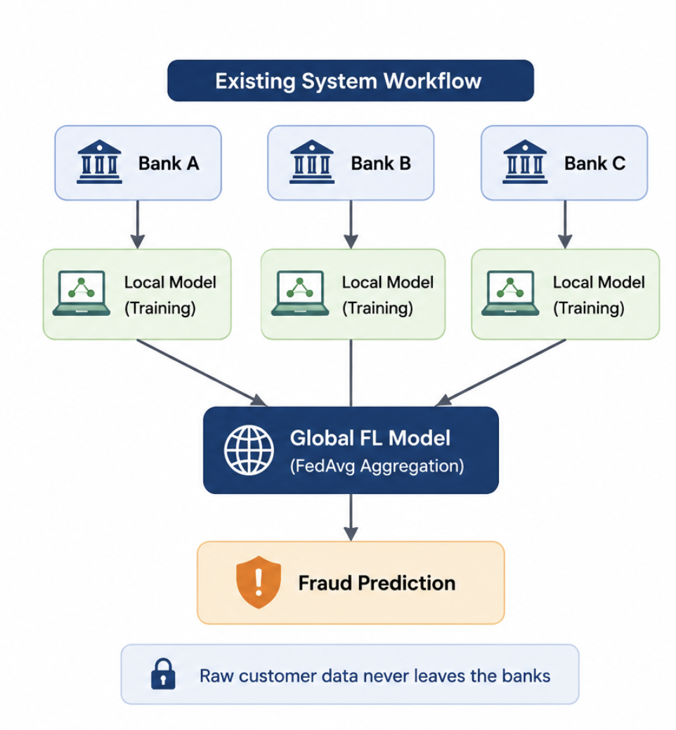
Existing System
Workflow: Local transaction data is processed by each bank, and model updates are aggregated into a global fraud detection model.
Advantage: Preserves customer privacy by keeping raw transaction data local.
Advantage: Enables collaborative learning across multiple financial institutions.
Limitation: Learns only global fraud patterns without user-specific personalization.
Limitation: Higher false positives for users with unique spending behaviors.

Slide 5
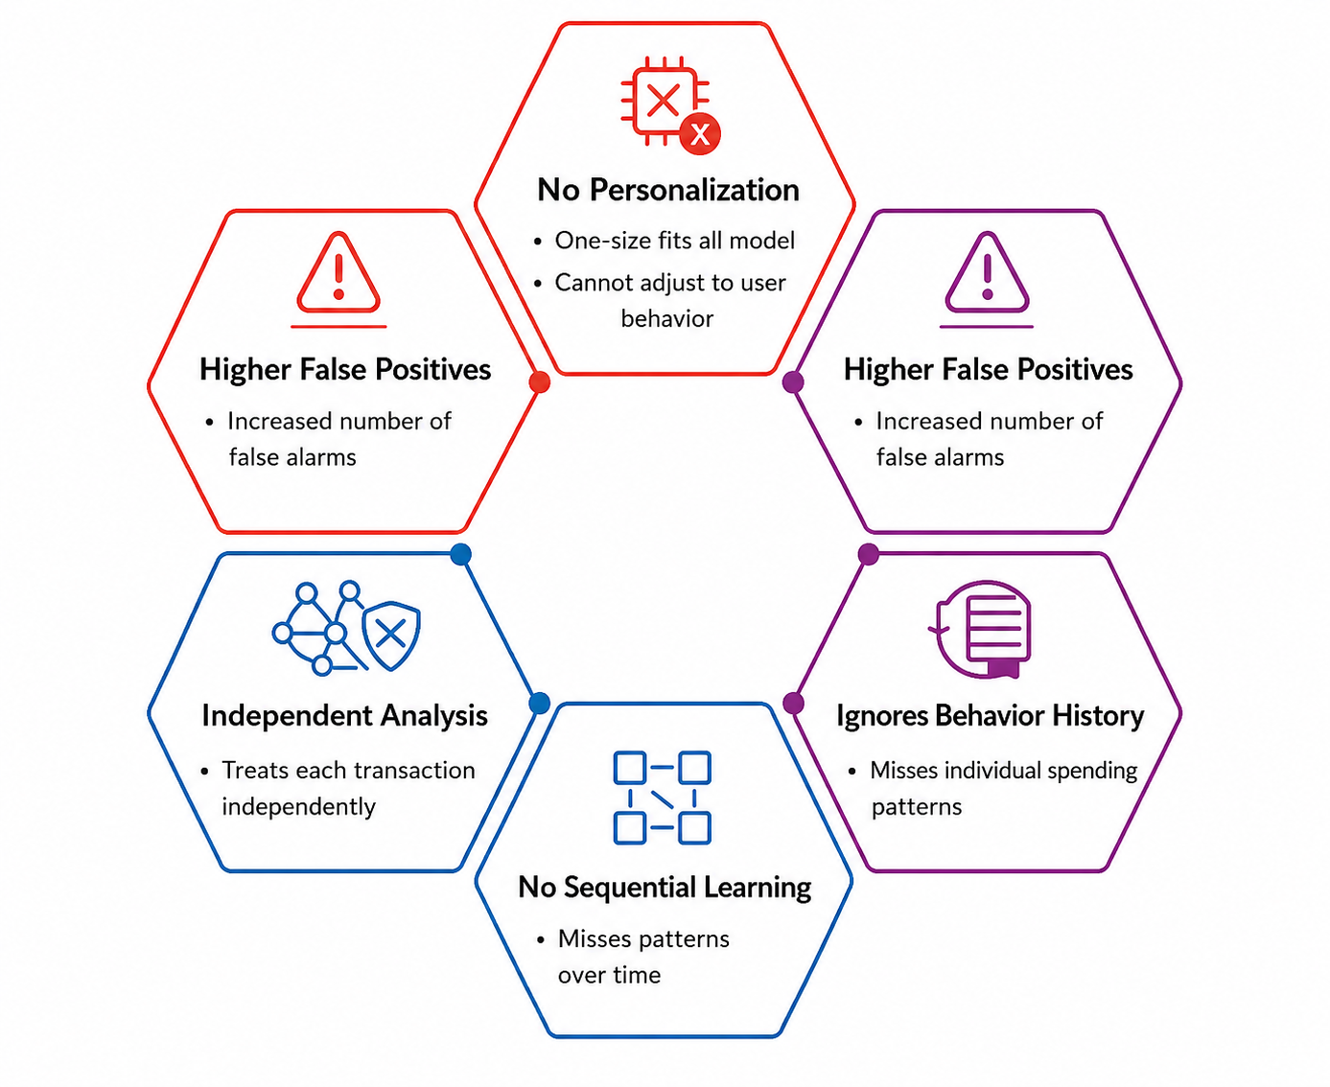
Disadvantages of Existing System
No user-level personalization
Higher false positive rate
Ignores individual behavioral history
Treats every transaction independently
No sequential or temporal learning

Slide 6
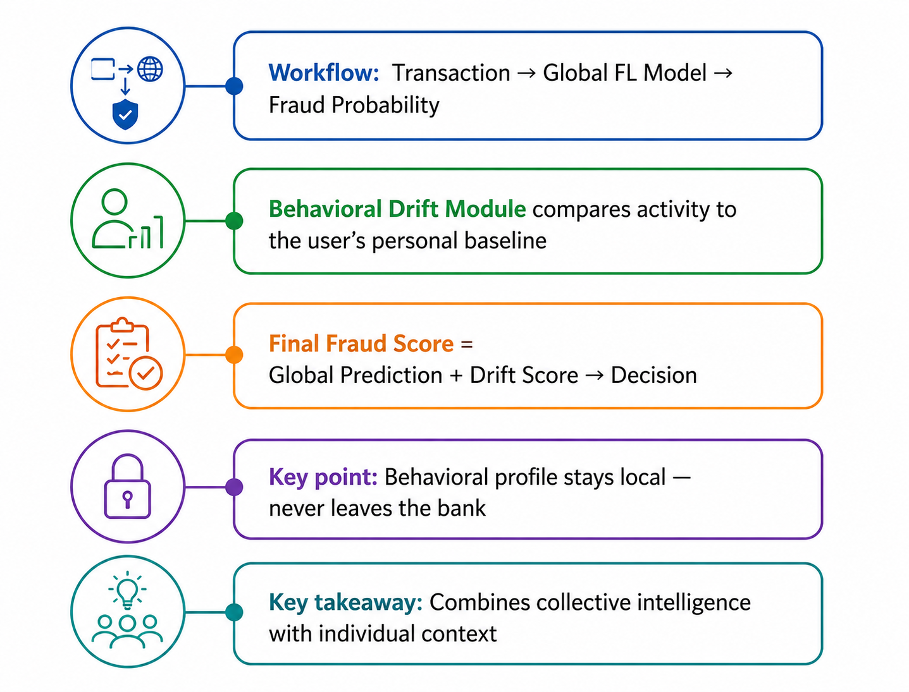
Proposed System
Workflow: Transaction → Global FL Model → Fraud Probability
Behavioral Drift Module compares activity to the user's personal baseline
Final Fraud Score = Global Prediction + Drift Score → Decision
Key point: Behavioral profile stays local — never leaves the bank
Key takeaway: Combines collective intelligence with individual context

Slide 7
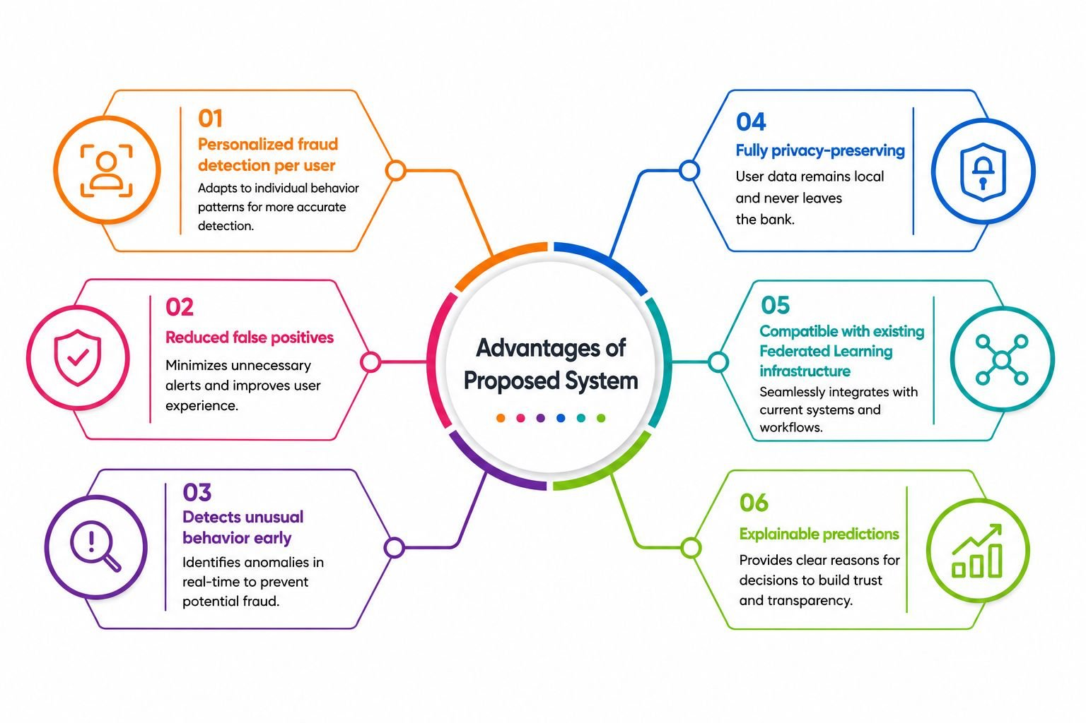
Advantages of Proposed System

Slide 8
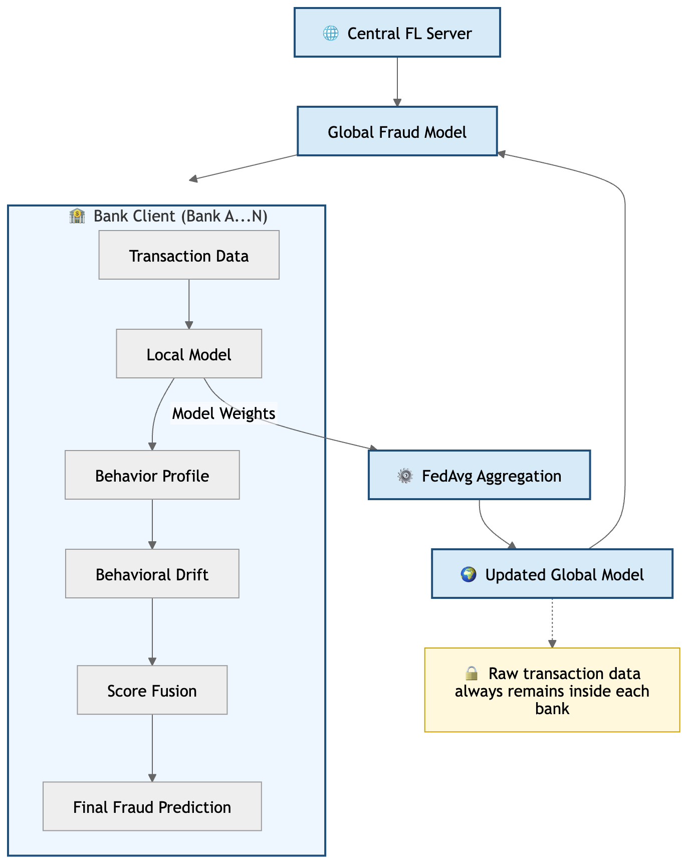
Architecture Diagram
Central FL Server → Global Model → sent to Bank A, Bank B, Bank C
Each bank: Transactions → Local Model → Behavior Profile → Drift Score → Final Score
Privacy rule: Only model weights return to the server
Privacy rule: No customer data ever leaves any bank

Slide 9
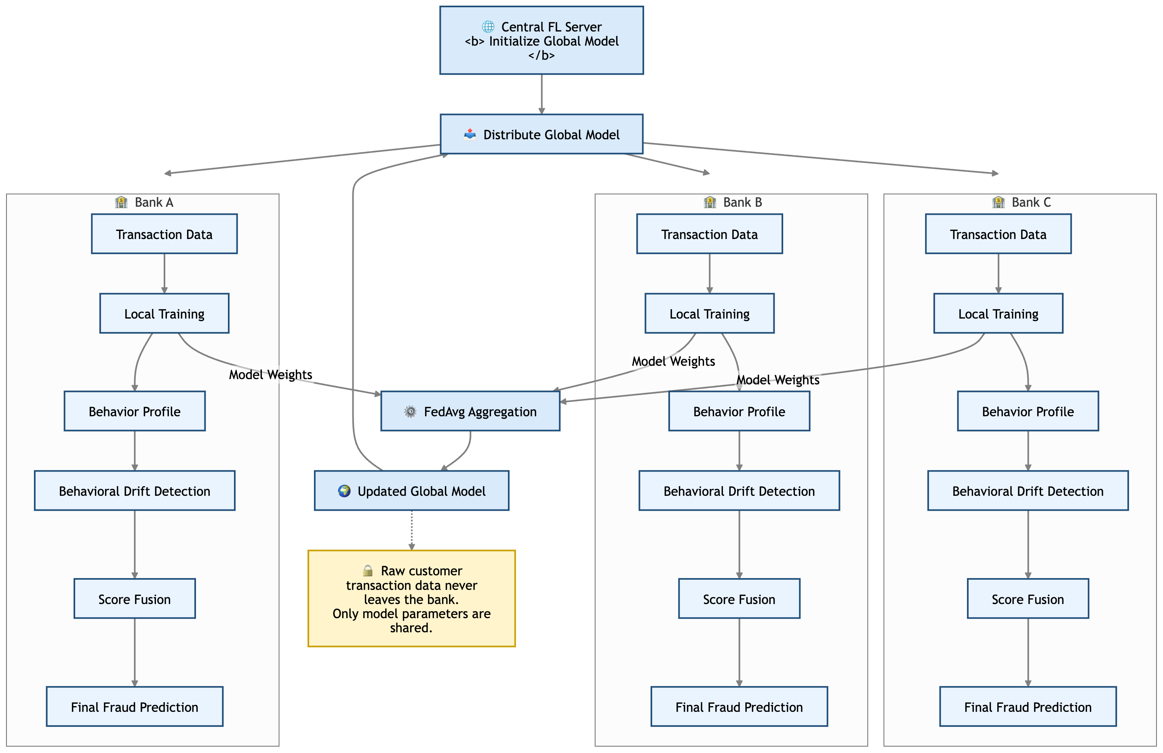
Architecture Diagram

Slide 10
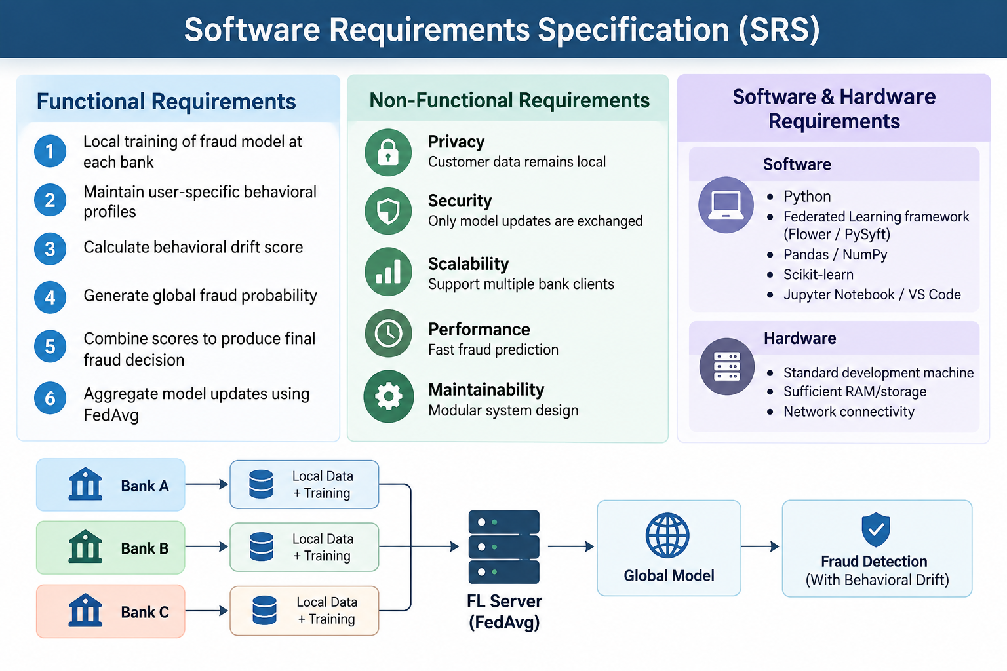

Slide 11
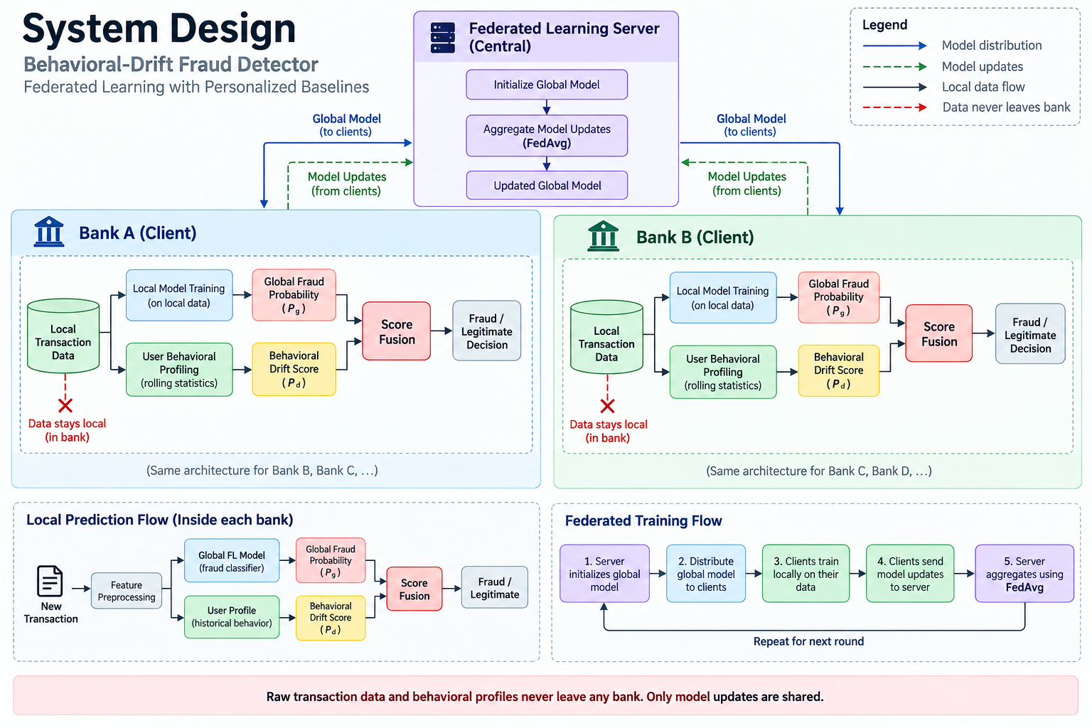

Slide 12
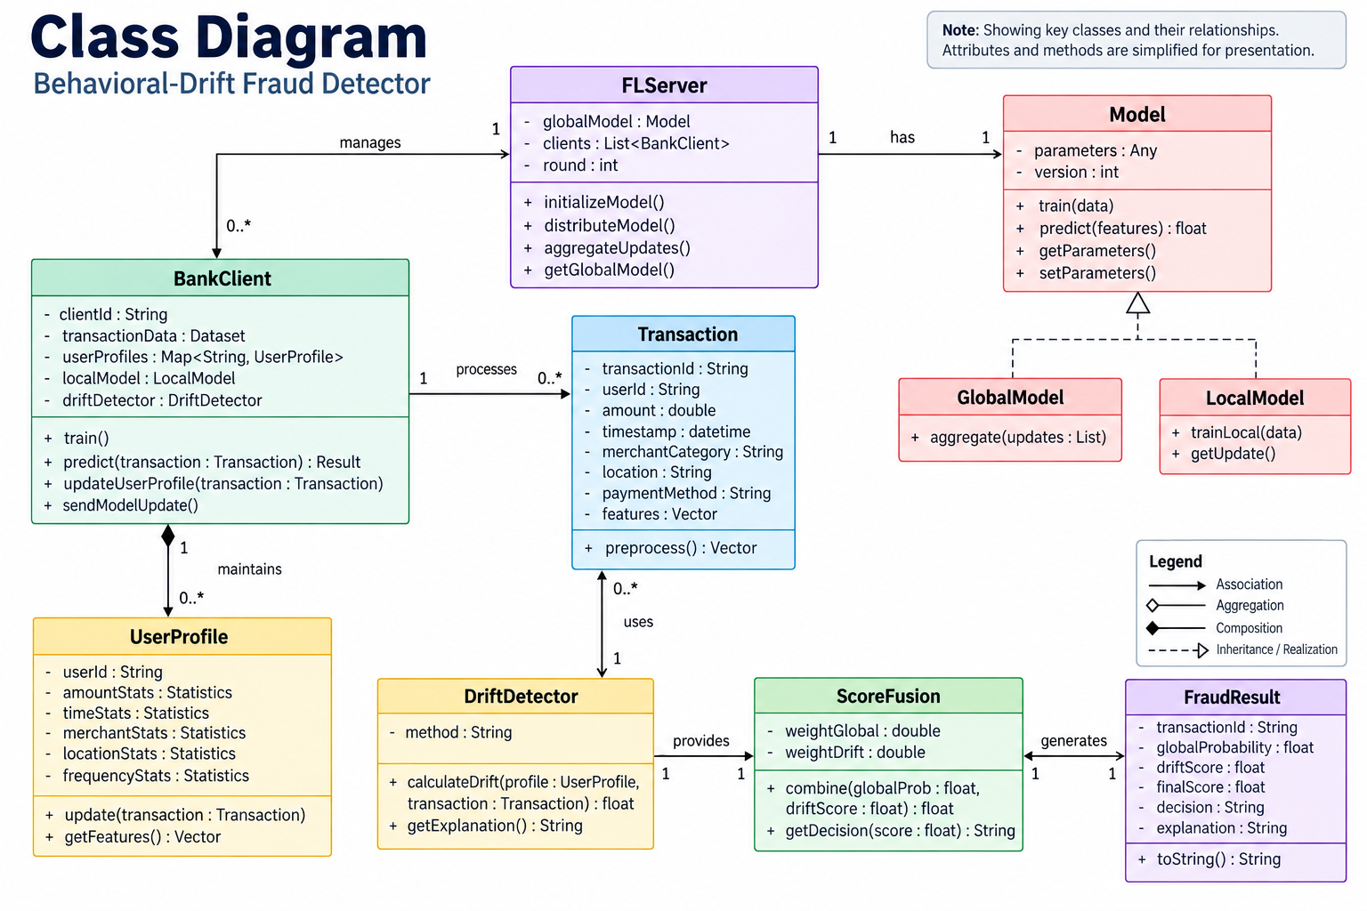

Slide 13
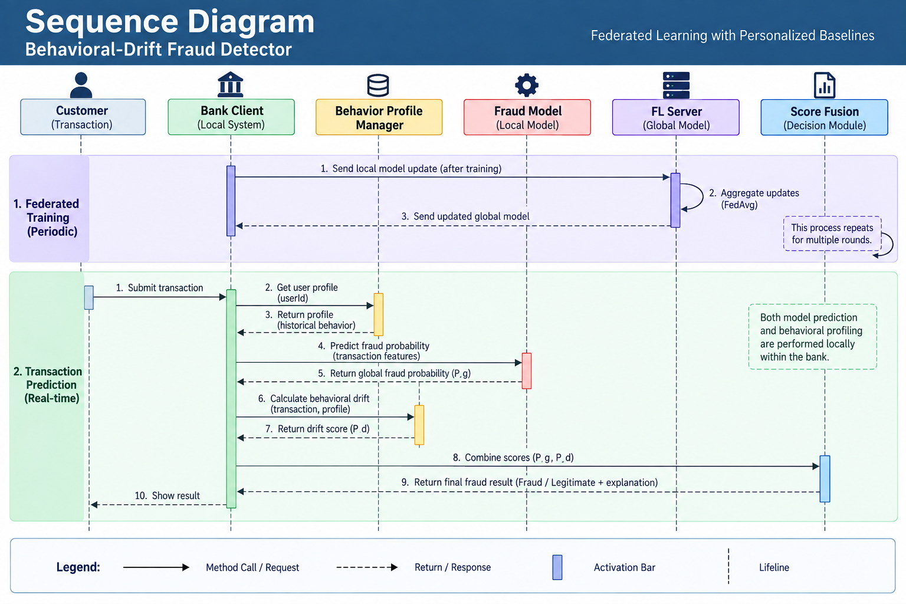

Slide 14
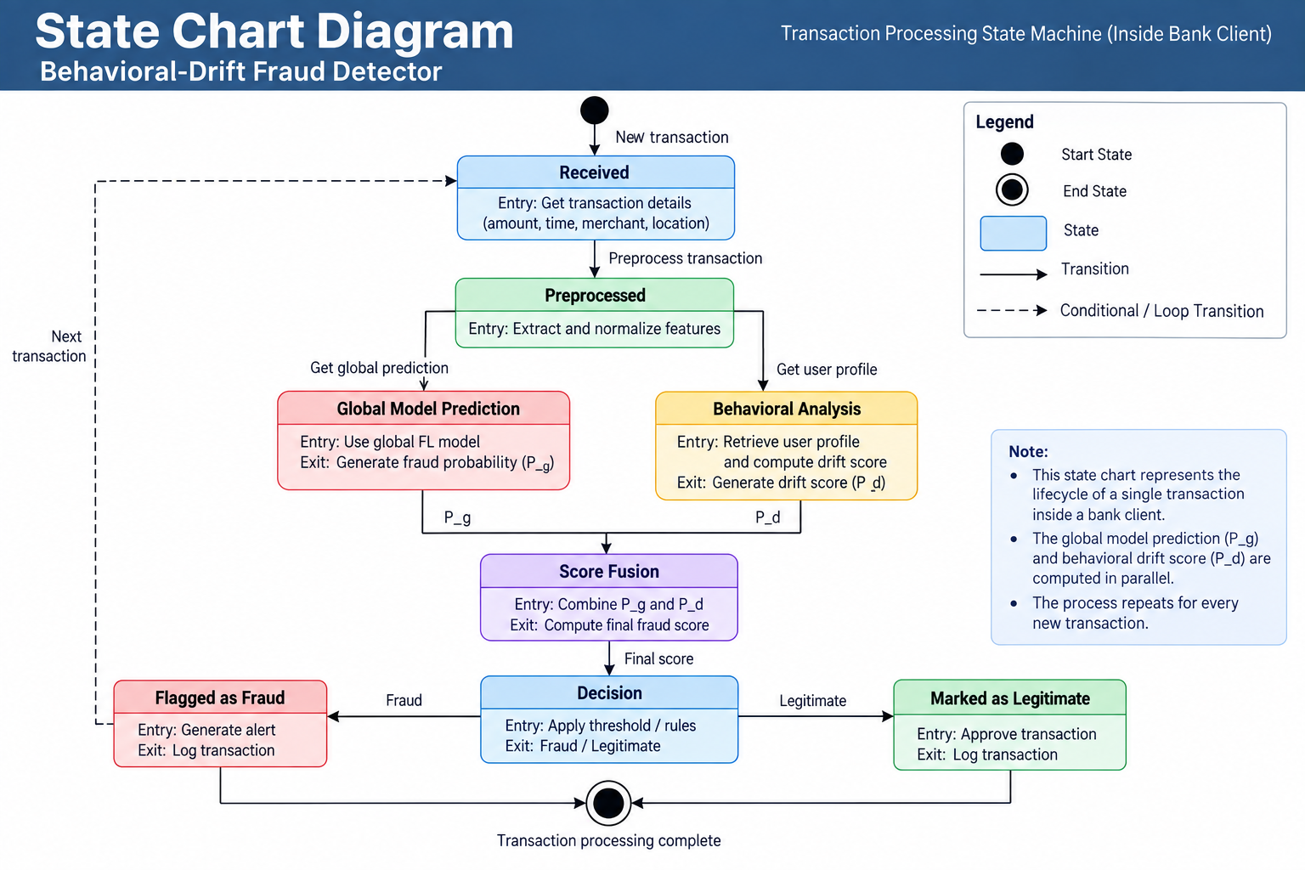

Slide 15
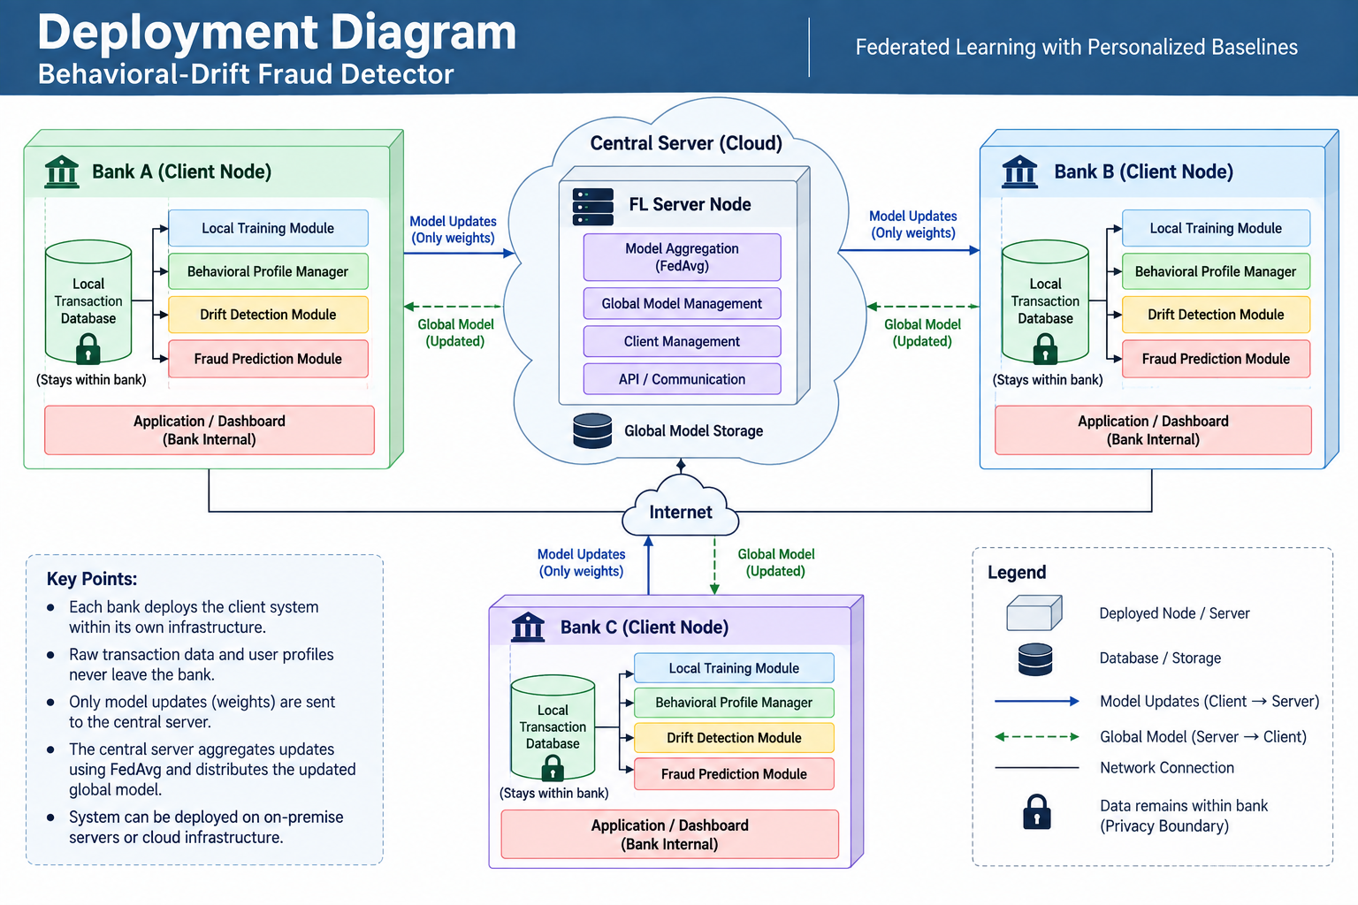

Slide 16
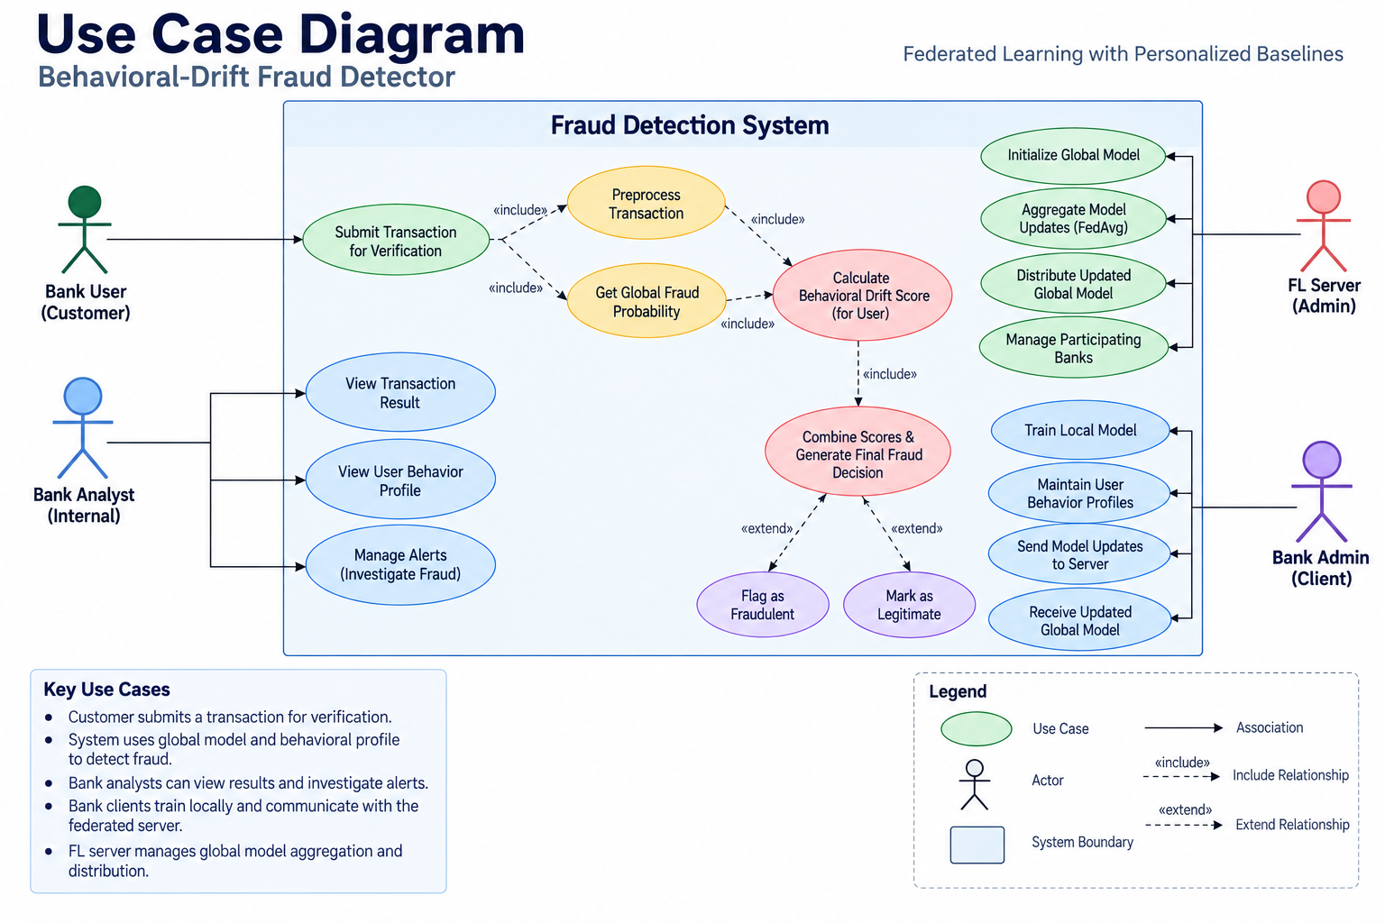

Slide 17
Thank You

